Slide 1
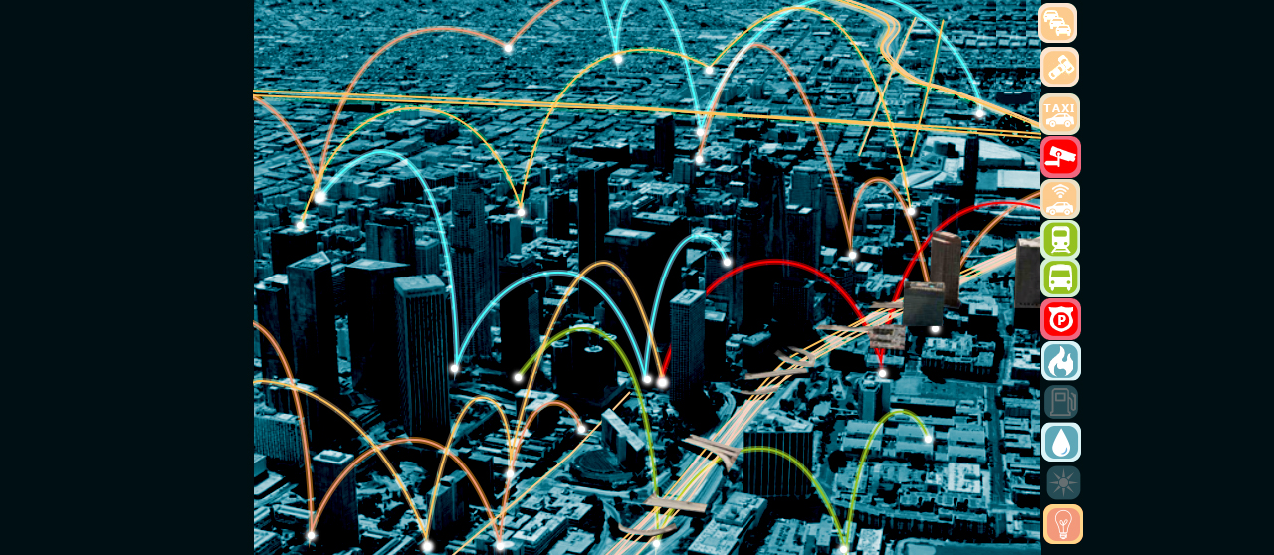


Autonomous Driving & Cognitive Agents Dream or Reality
Marcio Lobo Netto – Polytechnic School – USP

Slide 2
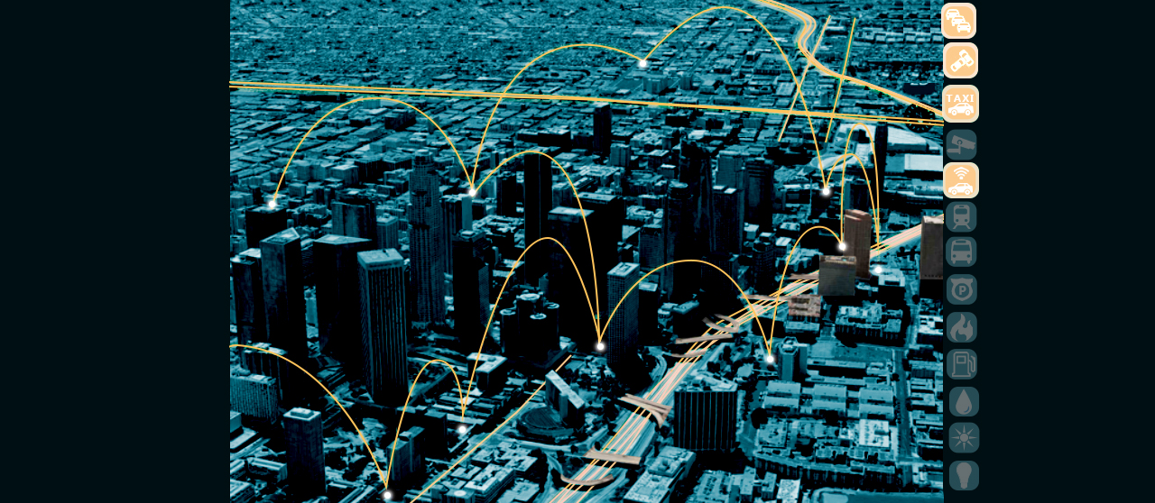
Why ?
Safety & Efficiency
How?
technology issues
Connectivity & Autonomy: Embedded Intelligence (adaptive balance)
(non)-autonomous vehicles sharing streets
When?
maturity quest
Crossing the paradigms border
Best transposition procedures?
Continuous evolution

Slide 3
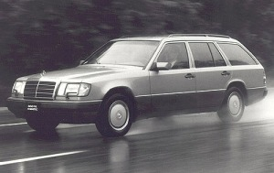
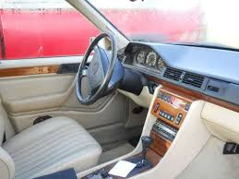
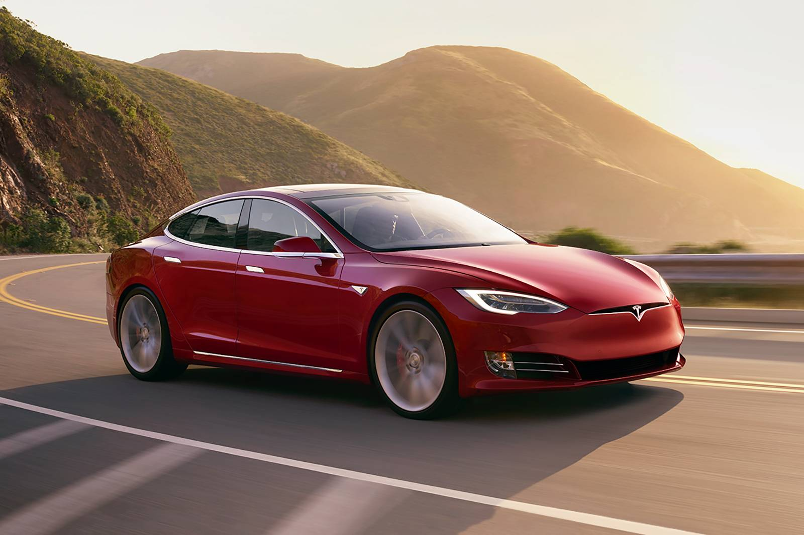
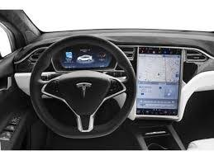
Tech Evolution 1992 … 2020 … 20??
1992 – 1994: Mercedes Benz
Transputer parallel computer
No GPS / just cameras
Self driving in German autobahns
2018 – 2020: Tesla
GPGPU deep learning
GPS / better cameras / lidar
Autonomous driving in US roads

Slide 4
Boundaries transposition coexisting with different paradigms
want to drive
don’t want to drive
allowed to drive
not allowed to drive

Slide 5
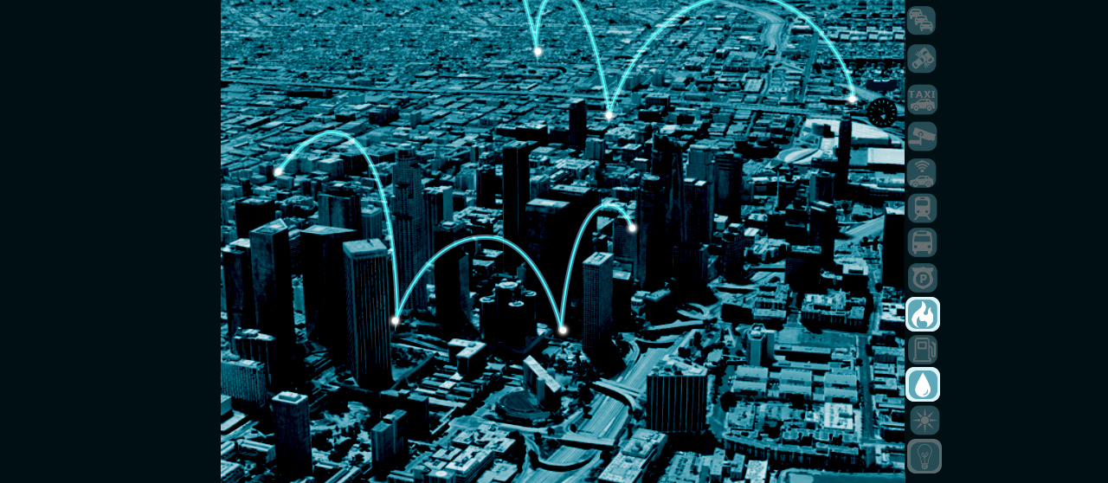
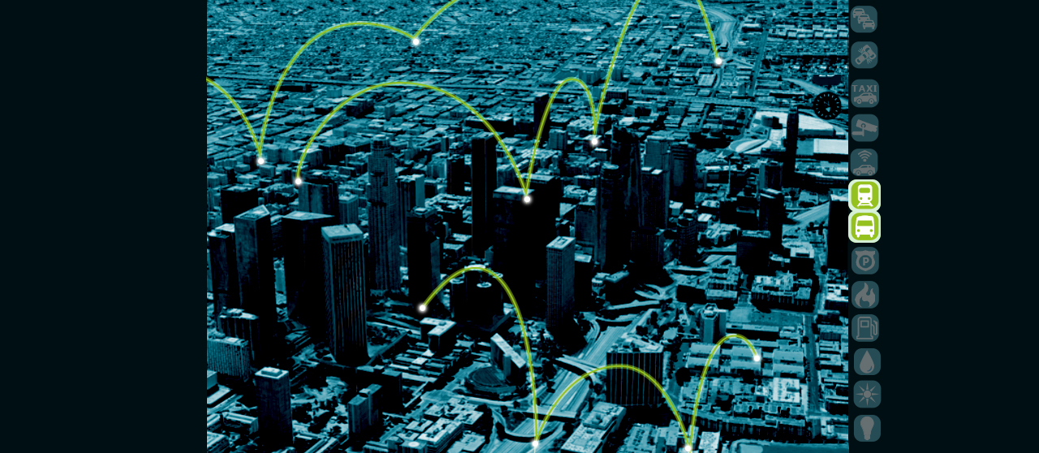
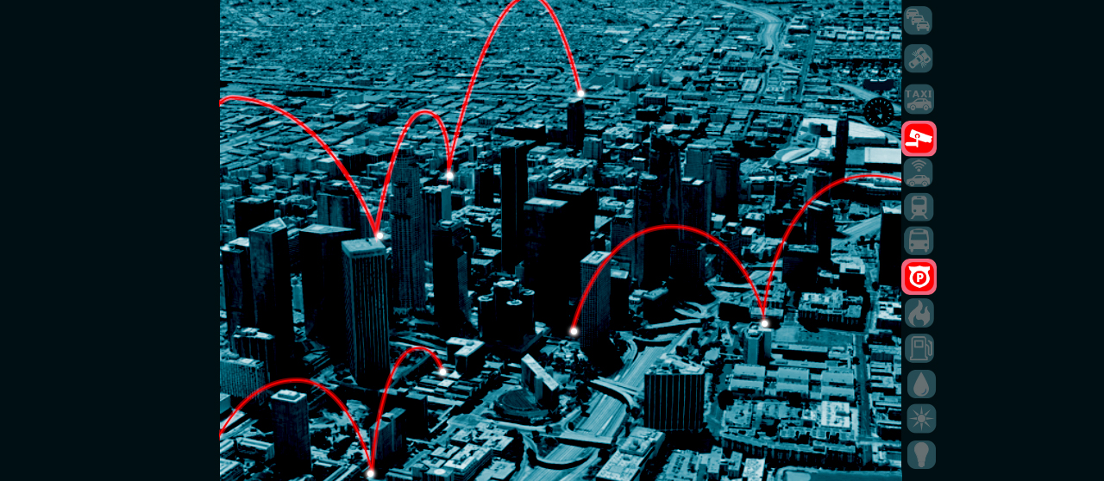
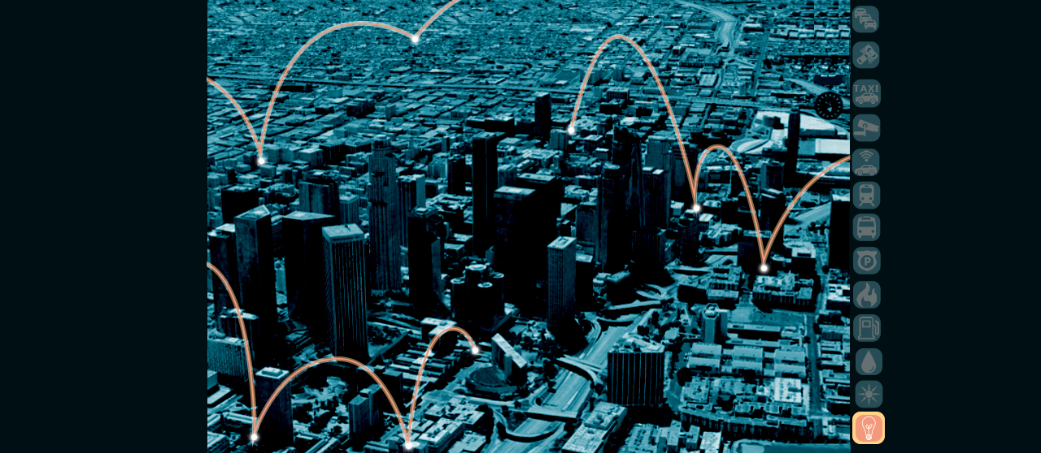
Smart City is heterogeneous
TOP DOWN
Designed
Engineered
Standards
Organic
Adaptive
BOTTOM
UP

Slide 6
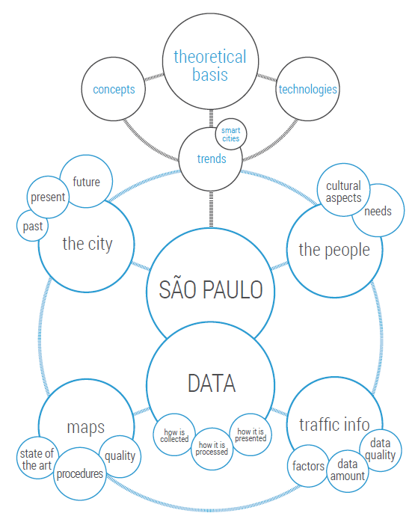
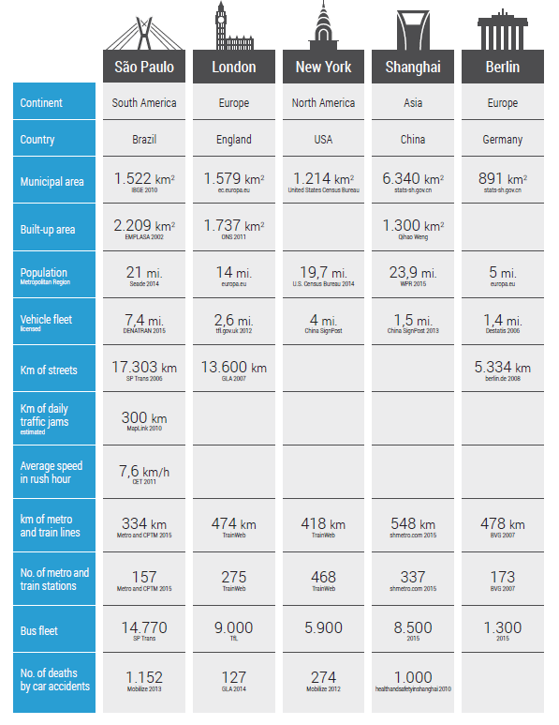
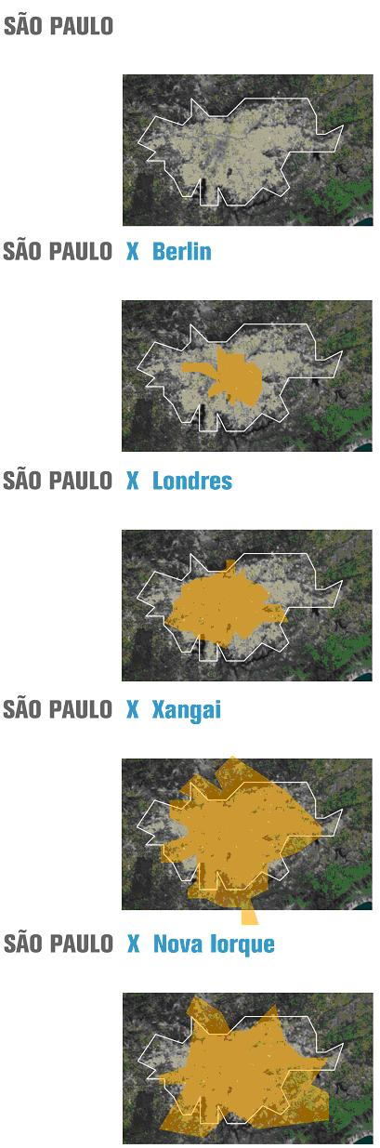

Slide 7
Smart City is plural
energy / security / resources / information / ……..
mobility & traffic
intelligent assistance
Autonomous Driving

Slide 8
Smart City autonomous driving
Being aware!
Following facts Taking decisions
Connectivity V2V V2I X2X - IoT(5G)
Autonomy full time responsiveness

Slide 9
Smart City autonomous driving
Tailored paradigm
General paradigm
situated SW
local apps
special purpose
large SW
global standards
general purpose (scenario transposition)

Slide 10
Smart City autonomous driving
Autonomy
Connectivity
Interdependency
Strong Weak
autonomy
connectivity
best balance

Slide 11
Smart City autonomous driving
neighborhood
centralized
Autonomy Sensing Deciding
Connectivity Communicating Sharing
Stand- Alone: Sensors (cameras / radars) Shared: IoT (5G)
Stand-Alone: DL / AI Shared: DL / AI
information threads
decision threads
Gathering
Sensing
Decision
Broadcasting
Sensing
Decision
Notes:
Connectivity
V2V / V2I / X2X
IoT (5G)
Autonomy
Being Responsiveness when infrastructure fails (connectivity)
Driving Assistance
What do we expect
Someone like our byside partner calling our attention if necessary?
A full decision-making assistant (able to drive all the time, in any conditions)
Different scenarios require different considerations
This seems obvious, but the hard thing is to define the boundaries – what is possible with which computing power?

Slide 12
Autonomous Driving requires both sensing & reasoning
Cognitive System
Symbolic AI
Deductive
Built Logic
Reasoning
Deep Learning
Inductive
Statistics
Perception

Slide 13


Cognitive System cognitive assistant operation modes
Automatic – performed by good practice
Does not require deep attention
Fast and efficient, as far as in expected conditions
Autonomous driving by CNN (deep learning)
Attention & reasoning – performed by reasoning
Slowly, but necessary under special circumstances
Agile to compare scenarios/ assess new conditions / propose new solution
Add-on to CNN – a cognitive assistant

Slide 14
Cognitive System cognitive assistant – being AWARE
Cognitive Tool (supportive)
Cognitive Agent (autonomous)
Embedded with cognitive capacities
Able to assist humans on actions requiring cognition
Extended reasoning, combining logical decisions with personal experience
Scenario recognition
How to act in all cases
Quick decisions - large set of actions ready to be taken

Slide 15

Deductive approach
Classical Artificial Intelligence (SAI)
Recipes as computer programs
Intelligent methods / approaches used to drive
Transferred to the self driving machine Computer program performs as its designer
Pros: we know how it works
Cons: limited to previously considered cases; most unexpected ones may be hard or impossible to solve
Notes:
Intelligent methods possessed by the analyst (programmer) to solve the issue are transferred to the machine that replaces the analyst.
So the computer program performs as his designer would
Cons: Limited to previously considered cases; Most unexpected ones may be hard or impossible to solve
Pros: We know how it works
(known by the computer analyst / programmer) …

Slide 16

Inductive approach
Machine learning on neuronal networks
Acting by consolidated experience
Long term training on large # of cases
The machine acquires the knowledge
Able to apply it to similar cases
Computer shows its acquired expertise
Pros: extended knowledge incorporating all trained and neighbor cases; technological advances in HW/SW; products developed specifically for autonomous driving
Cons: we don’t know how it works, and surprises may arise
Notes:
So the intelligent method is what comes to be the post trained machine, able to solve any similar issues to those it has been presented to. So the computer program performs in accordance to its own acquired experience
Pros: extended knowledge incorporating all trained and neighbor cases
Cons: we don’t know how it works, and surprises may arise. It has no idea about what it is performing
Deep Learning
The machine acquires the expertise by extreme training, becoming able to solve any similar cases it may face

Slide 17
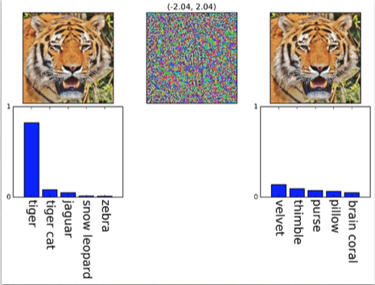
Combined approach
Taking the best side of deductive & inductive
The problem is how to combine, to balance
Cognitive Computing is more general
Considers different sides of human mental processes in order to build an artificial mind (cognitive system)
Notes:
So the intelligent method is what comes to be the post trained machine, able to solve any similar issues to those it has been presented to. So the computer program performs in accordance to its own acquired experience
Pros: extended knowledge incorporating all trained and neighbor cases
Cons: we don’t know how it works, and surprises may arise. It has no idea about what it is performing
Deep Learning
The machine acquires the expertise by extreme training, becoming able to solve any similar cases it may face

Slide 18
Boundaries transposition coexisting with different paradigms
From the current scenario (2020) to the future one (20??)
Direct transposal is impossible
Different systems need to co exist
Both conditions need to superpose
Old & New cars: (non)-autonomous
Old & New urban infrastructure: (without)-assistance
Full
Autonomous
Non
Autonomous
?

Slide 19












Intelligent Inference Tools (USP BMW)
Replicable model for other locations
SENSOR LAYER
DATA LAYER
ONTOLOGY LAYER
APPLICATION LAYER
Waze
Google Maps
Smart Track
Notes:
Data harvested from different sources:
> online sensors in different networks
> manually input or historical data
Data Layer distributed between databases
Network of modular ontologies enables the most intelligent applications

Slide 20
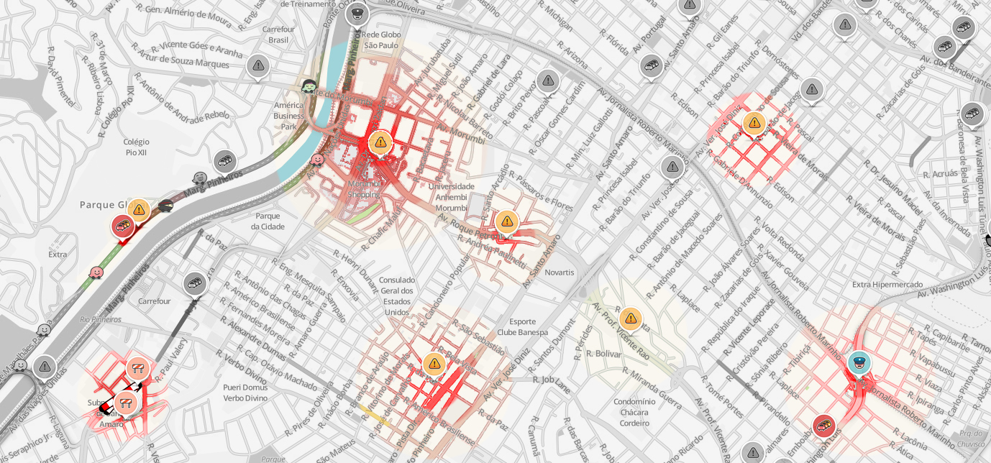
General Mobility tool
Interferences on the traffic
EVENT
CROWDING
NUMBER OF VEHICLES
BUMPY ROAD
FLOOD
PUBLIC SAFETY
ROAD WORKS
ACCIDENT
OTHER

Slide 21
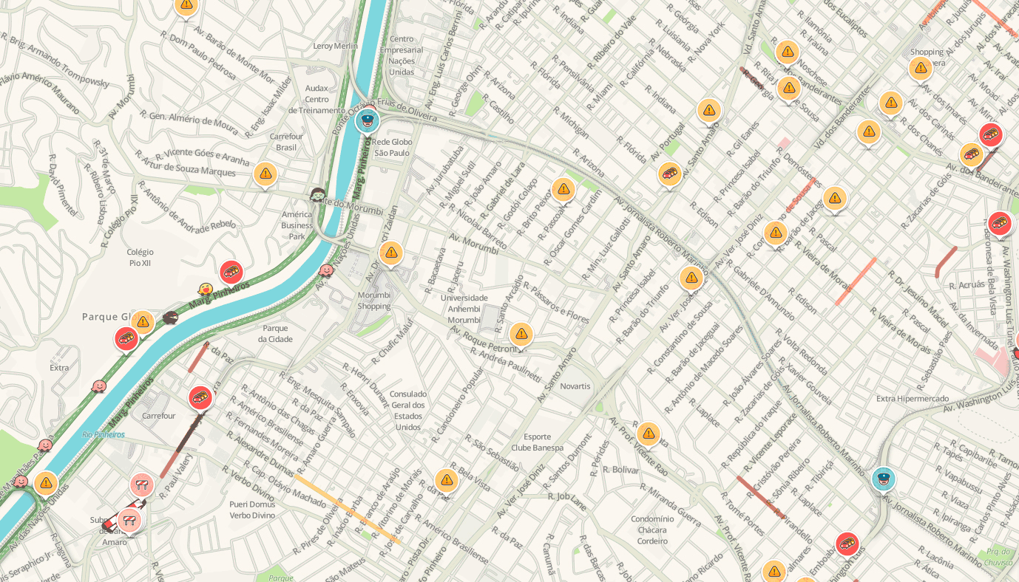
General Mobility tool
Interferences on the traffic
TIME 00
TIME +15’
TIME +30’
TIME +45’
TIME +60’
TIME +75’
TIME +90’
TIME +105’
TIME +120’

Slide 22








Autonomous Driving human centric
whatever it may be …
… it should be developed
to improve human mobility,
with efficiency, safety and
comfort
Thanks
marcio.netto@usp.br

